Slide 1
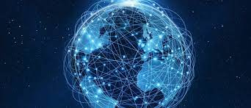
IoP
Internet of Things
This is a presentation of the internet of things, how it was initiated, its abilities in our current world, its pros and cons and lastly- how will out future benefit from it

Slide 2
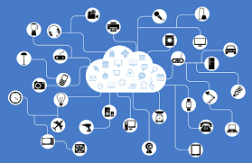
What is the Internet of Things
The Internet of things describes the network of physical objects that are embedded with sensors, software, and other technologies for the purpose of connecting and exchanging data with other devices and systems over the Internet.
Networking of the internet amongst these things will not only connect or transfer data from only these physical or tangible things but they will be effective to human beings in an exceptional way where they will be able to identify problems, habits, dictate emotions and the connection of all these things will prompt a solution to whatever emotion you have or condition you might be experiencing.
Things that we already have that are proof that this world of the internet is evolving are:
Smart phones
Laptops
Smart farming
Smart contact lenses
Smart watches
Self-driving cars
Electric windows and curtains

Slide 3
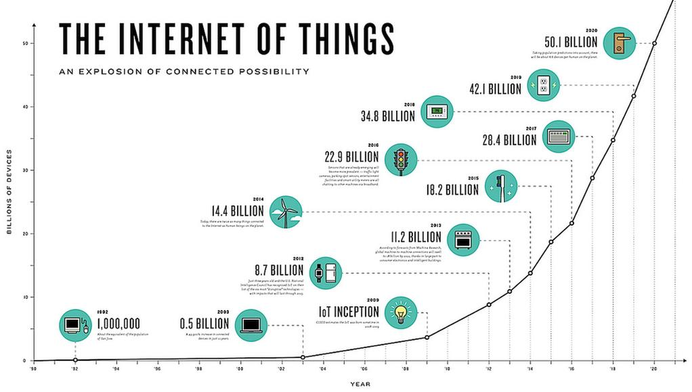
What is the history of IoT
Kevin Ashton
Kevin Ashton is an innovator and consumer sensor expert who coined the phrase “the Internet of Things” to describe the network connecting objects in the physical world to the Internet.
The Internet, itself a significant component of the IoT, started out as part of DARPA (Defense Advanced Research Projects Agency) in 1962, and evolved into ARPANET in 1969. In the 1980s, commercial service providers began supporting public use of ARPANET, allowing it to evolve into our modern Internet. Global Positioning Satellites (GPS) became a reality in early 1993, with the Department of Defense providing a stable, highly functional system of 24 satellites. This was quickly followed by privately owned, commercial satellites being placed in orbit. Satellites and landlines provide basic communications for much of the IoT.
One additional and important component in developing a functional IoT was IPV6’s remarkably intelligent decision to increase address space. Steve Leibson, of the Computer History Museum, states, “The address space expansion means that we could assign an IPV6 address to every atom on the surface of the earth, and still have enough addresses left to do another 100+ earths.” Put another way, we are not going to run out of internet addresses anytime soon.
Simply stated, the Internet of Things consists of any device with an on/off switch connected to the Internet. This includes almost anything you can think of, ranging from cellphones to building maintenance to the jet engine of an airplane. Medical devices, such as a heart monitor implant or a biochip transponder in a farm animal, can transfer data over a network and are members the IoT. If it has an off/on switch, then it can, theoretically, be part of the system. The IoT consists of a gigantic network of internet connected “things” and devices

Slide 4
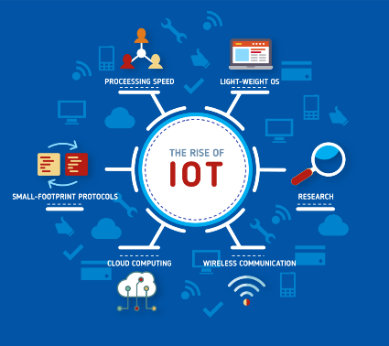
What technologies enable IoT?
IoT primarily exploits standard protocols and networking technologies. However, the major enabling technologies and protocols of IoT are RFID, NFC, low-energy Bluetooth, low-energy wireless, low-energy radio protocols, and LTE-A. These technologies support the specific networking functionality needed in an IoT system in contrast to a standard uniform network of common systems.
As well as these enabling technologies, the IoT also relies on other technologies to maximise the opportunities that are created by the IoT. These include:
Big Data
Cloud Computing
Sensors
Analytics Software
These supporting technologies are there to ensure the data from IoT devices can be collected, stored, and analysed. However, let’s take a closer look at the enabling technologies for the Internet of Things
Bluetooth Low Energy (BLE)
This technology supports the low-power, long-use need of IoT function while exploiting a standard technology with native support across systems. Bluetooth Low Energy is well suited to relatively short-range communications scenarios that involve low-to-medium throughput. Telemetry, fitness and health, and human interface device (HID) applications are key targets for this technology.
Low Energy Wireless
Power is a problem for IoT developers – and communication links are one of the most power-hungry elements of a typical system. Whilst sensors and other peripherals can be powered down for long periods of time, communications, particularly receivers, often need to be kept in listening mode for transmissions.LTE-A (LTE Advanced)
LTE-A, or LTE Advanced, delivers an important upgrade to LTE technology by increasing not only its coverage but also reducing its latency and raising its throughput. It gives IoT a tremendous power through expanding its range, with its most significant applications being vehicle, UAV, and similar communication.
NEC and IoT technology
NEC are also currently developing pay by face solutions that can utilise BLE as dual-factor authentication and enhanced customer experience with proximity sensing to alert customers with targeted marketing and digital signage.

Slide 5
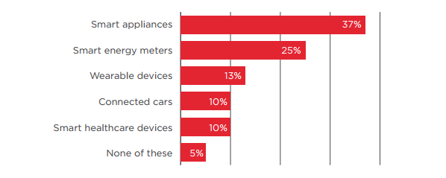
What is its impact?
Finally, IoT is making people’s homes more user friendly and safer with connected apps that control appliances and security systems.We have seen IoT make an impact across the planet, but what we are seeing is only a small part of what IoT applications are capable of. In a few short years, we are set to become even better connected.
Data analytics can be a cumbersome and time-consuming job. For human staff to be in charge of analyzing the reams of data being collected, businesses would need to put aside a great deal of time and energy that they don’t have.
Which is why so many businesses are turning to IoT applications—such as ThingSpeak, Zatar, Google Cloud, GroveStreamsthat are making the analysis process much faster and more efficient.
Farming and IoT devices, machines, and even vehicles have become connected through IoT and, as a result, have improved farming efficiency, become less labor-intensive, and improved average order. Now, drones are flying over farms, sharing live feeds of aerial footage of the farm, along with data about areas that need attention. Drones can even deliver pesticides and fertilisers to select areas using lasers for precision delivery.
IoT in Healthcare- A number of IoT applications in healthcare are using RFID (radio-frequency identification) tags that are embedded in the skin of cancer patients. They are also connected to bluetooth activity trackers worn by patients. These tags monitor patients at all times and share real-time data with carers and doctors. With IoT technology, carers and doctors are able to identify changes in health and side-effects faster than ever before.
IoT in Manufacturing - Now, IoT gives businesses in-depth shop floor data through the use of RFID tags, and sensors, each with its own unique identifying information. All the data collected from these tags is stored in the cloud, making it easy to sort through, categorize, and monitor. IoT also helps businesses examine the state of their machinery, even remotely, with oT-optimized sensors that are attached to the machinery to track their health and status
Smart Homes - IoT apps are connected to security devices and locks—thus removing the need for the age-old lock and key we use to enter our homes.

Slide 6
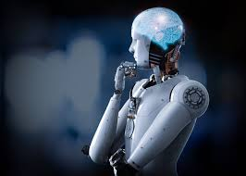
What is its impact going to be in the future?
The future of IoT has the potential to be limitless. Advances to the industrial internet will be accelerated through increased network agility, integrated artificial intelligence (AI) and the capacity to deploy, automate, orchestrate and secure diverse use cases at hyperscale.
A great transformation can be observed in our daily routine life along with the increasing involvement of IoT devices and technology. One such development of IoT is the concept of Smart Home Systems (SHS) and appliances that consist of internet based devices, automation system for homes and reliable energy management system . Besides, another important achievement of IoT is Smart Health Sensing system (SHSS). SHSS incorporates small intelligent equipment and devices to support the health of the human being. These devices can be used both indoors and outdoors to check and monitor the different health issues and fitness level or the amount of calories burned in the fitness centre etc. Also, it is being used to monitor the critical health conditions in the hospitals and trauma centers as well. Hence, it has changed the entire scenario of the medical domain by facilitating it with high technology and smart devices . Moreover, IoT developers and researchers are actively involved to uplift the life style of the disabled and senior age group people. IoT has shown a drastic performance in this area and has provided a new direction for the normal life of such people. As these devices and equipment are very cost effective in terms of development cost and easily available within a normal price range, hence most of the people are availing them . Thanks to IoT, as they can live a normal life. Another important aspect of our life is transportation. IoT has brought up some new advancements to make it more efficient, comfortable and reliable. Intelligent sensors, drone devices are now controlling the traffic at different signalized intersections across major cities. In addition, vehicles are being launched in markets with pre-installed sensing devices that are able to sense the upcoming heavy traffic congestions on the map and may suggest you another route with low traffic congestion . Therefore IoT has a lot to serve in various aspects of life and technology. We may conclude that IoT has a lot of scope both in terms of technology enhancement and facilitate the humankind.
IoT has also shown its importance and potential in the economic and industrial growth of a developing region. Also, in trade and stock exchange market, it is being considered as a revolutionary step. However, security of data and information is an important concern and highly desirable, which is a major challenging issue to deal with . Internet being a largest source of security threats and cyber-attacks has opened the various doors for hackers and thus made the data and information insecure. However, IoT is committed to provide the best possible solutions to deal with security issues of data and information. Hence, the most important concern of IoT in trade and economy is security. Therefore, the development of a secure path for collaboration between social networks and privacy concerns is a hot topic in IoT and IoT developers are working hard for this.

